Slide 1


THE EAGLE TRAIL
What Is It?
How Do You Get There?

Slide 2
What Is the Eagle Trail?
The Eagle Trail is a roadmap to becoming an Eagle Scout
It includes Tenderfoot, Second Class, First Class, Star, Life and Eagle Scout
It is a 3-6 year commitment by both the Scout and his family
The end result is a young adult with valuable lifetime skills

Slide 3
How Do I Become An Eagle Scout?
You begin with fundamental Scouting skills via Tenderfoot, Second Class and First Class
You then develop advanced Scouting skills via merit badges, troop leadership positions and community service projects
You finish the Eagle Trail by completing 21 merit badges (11 Eagle badges required) and a large community service project

Slide 4
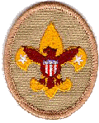
Tenderfoot Requirements
KNOWLEDGE
Scout Oath
Scout Law
Scout Motto
Scout Slogan
Scoutmaster conference
Board of Review
EXPERIENCE
One campout
Basic knots
Flag protocol
Buddy system
Physical fitness
Poisonous plants
First aid

Slide 5
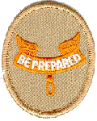
Second Class Requirements
EXPERIENCE
5 troop activities
Flag ceremony
Service project
Drug, alcohol, tobacco dangers
Scoutmaster conference
Board of Review
SKILLS
Orienteering
Wild animals
First aid
Swimming

Slide 6
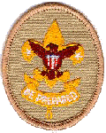
First Class Requirements
EXPERIENCE
10 troop activities
Service project(s)
Internet safety
Scoutmaster conference
Board of Review
SKILLS
Cooking
Knots
Native plants
Swimming
First aid

Slide 7
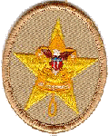
How Do You Get A Merit Badge?
THREE OPTIONS
  Boy Scout Camp
  Merit Badge Midway
  Schedule with individual merit badge counselors
BE PREPARED
  Sign up early
  Read the merit badge handbook
  Complete the prerequisites
  Fill out the Merit Badge worksheet

Slide 8
Star Requirements
6 merit badges including 4 Eagle badges
6 hours of Service Projects
Troop Leadership for 4 months
Scoutmaster Conference
Board of Review

Slide 9
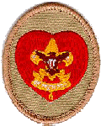
Life Requirements
11 merit badges including 7 Eagle badges
6 hours of Service Projects
Troop Leadership for 6 months
Scoutmaster Conference
Board of Review

Slide 10
Eagle Requirements
21 merit badges including 11 Eagle badges
Troop Leadership for 6 months
Eagle Project (60-80 hours)
  Project approved by Scout Council
  Must include other Scouts
  Project write up and final presentation
Eagle Board of Review

Slide 11
What Does It Take To Become An Eagle Scout?
Individual Commitment
Participation in troop activities
Leadership Role
Community Service
Teamwork and Mentoring

Slide 12
What Are the Benefits of Being An Eagle Scout?
Once An Eagle Scout, Always An Eagle Scout
Skills
  Leadership
  Community Service
  Survival Skills
  Personal Management and Family Life
  Citizenship

Slide 13
What Are the Benefits of An Eagle Scout?
Experiences
  Camping, Hiking, Rafting, Skiing, Fishing, Cooking
  Volunteer activities and service projects
  Your Most Important Achievement as a Young Adult
Credentials
  College applications
  Job resumes
  A certified Outdoorsman and Scout Citizen

